Slide 1
CS542, Fall 2016
Paper presentation
Inter domain Routing, BGP
Sungjoon Park

Slide 2
Inter domain Routing, BGP
Contents
On characterizing BGP Routing Table Growth (98~02)
1. Background
2. Quantification of the growth factors
3. Growth rate of each contributors
4. Routing table size & routable addresses
5. Prefix growth at different mask length
BGP Routing Table : Trends and Challenges (03~09)
1. Introduction
2. IP allocation dynamics
3. BGP routing table growth factors
4. BGP routing table contents
Notes:
Using Oregon route server data (98~02) / Oregon Route Views and RIPE NCC Routing Information Service projects (03~09)

Slide 3
On characterizing BGP Routing Table Growth (98~02)
1. Background
Internet Architecture : divided into thousands of ASes.
BGP: Inter-domain routing protocol.
Key component enabling Internet routing worldwide.
Connecting independent ASes (separate networks, economic entries).
Tries to satisfy ISP-specific routing policies
Route Aggregation : Scalability of routing infra depends on this, but not always possible
Multi-homed : multiple providers to ensure connectivity, can’t aggregate prefixes
Load-balancing : AS originates several different prefixes for each path.
Fragmentation : allocated IP address are not aggregatable with previous ones
Routing tables : Each BGP speaker router maintain a routing table
Table size : the number of prefixes appeared in the table
the extent that route aggregations are performed directly affects the routing table size

Slide 4
On characterizing BGP Routing Table Growth (98~02)
1. Background
The size of a BGP routing table, i.e., the number of prefixes contained in the routing table, has risen from 10,000 to 100,000 over the past six years.
May decrease the packet forwarding speed, demand more router memory space.
Exploring the contribution to routing table size of :
Multi-homing (20~30% extra prefixes, fast growth)
Many ASes connect to more than one provider for the purpose of fault tolerance
Failure to Aggregate (15~20% extra prefixes)
Load Balancing (20~25% extra prefixes, fastest growing factor)
Many ASes announce different prefix for each path
Address Fragmentation (75~% extra prefixes, contributes the most)
Load Balancing and Multihoming contribute to the routing table growth by introducing more prefixes of length greater than 17 but less than 25, which are the fastest growing prefixes.
The demand of routing more IP address can contribute to routing table growth as well, but major contributor of the routing table growth is not the increase on routable IP addresses

Slide 5
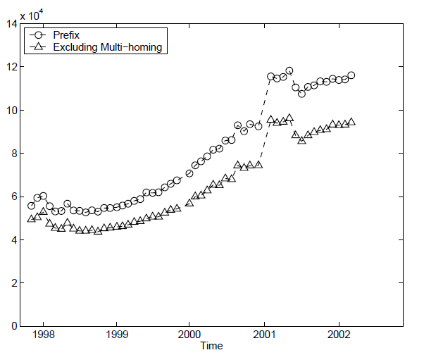
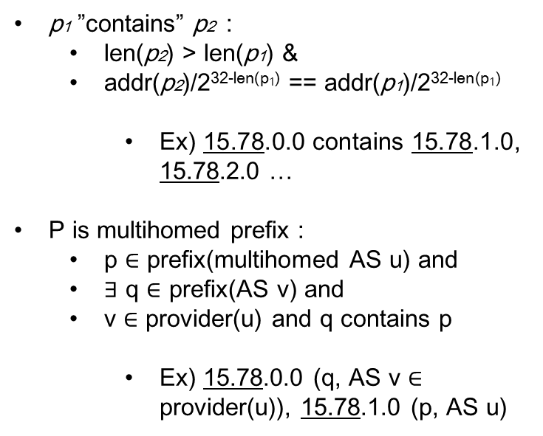
On characterizing BGP Routing Table Growth (98~02)
2. Quantification of growth factors
a) Multi-homing:
p1 ”contains” p2 :
len(p2) > len(p1) &
addr(p2)/2^{32-len(p1)} == addr(p1)/2^{32-len(p1)}
Ex) 15.78.0.0 contains 15.78.1.0, 15.78.2.0 …
P is multihomed prefix :
p $∈$ prefix(multihomed AS u) and
$∃$ q $∈$ prefix(AS v) and
v $∈$ provider(u) and q contains p
Ex) 15.78.0.0 (q, AS v $∈$ provider(u)), 15.78.1.0 (p, AS u)
20~30% more prefixes

Slide 6
On characterizing BGP Routing Table Growth (98~02)
2. Quantification of growth factors
b) Failure to Aggregate
prefix cluster : maximal set of prefixes whose routing table entries are the same in every BGP routing tables in the Internet.
p1 and p2 belongs to the same cluster :
RouteEntry(p1) == RouteEntry(p2)
Then, in the same cluster, iteratively aggregate for consecutive prefixes based on the sorted table:
p1 and p2 are “aggregatable”:
len(p2) = len(p1) &
addr(p1)/2^{32-len(p1)} +1 = addr(p2)/2^{32-len(p2)} &
addr(p1)/2^{32-len(p1)} +1 = 0
Ex) 15.78.1.0 and 15.78.2.0 are aggregatable
The total number of prefixes after the aggregation is the number of prefixes excluding those are introduced by failure to aggregate

Slide 7
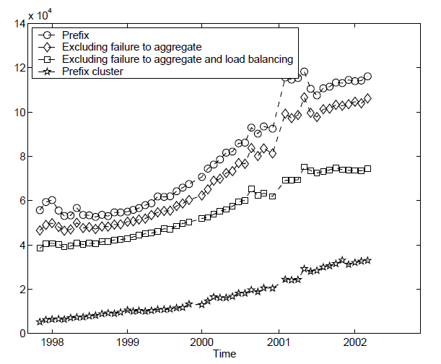
On characterizing BGP Routing Table Growth (98~02)
2. Quantification of growth factors
b) Failure to Aggregate
15~20% more prefixes

Slide 8
On characterizing BGP Routing Table Growth (98~02)
2. Quantification of growth factors
c) Load Balancing
Aggregate all aggregatable prefixes originated by the same AS
independent of whether those prefixes are announced identically or not.
The prefixes after the aggregation exclude the contribution of
both failure to aggregate and load balancing
Difference between the total number of prefixes after the aggregation with
the number of prefixes excluding those introduced by failure to aggregate
d) Address Fragmentation
Difference between the number of prefixes excluding those contributed by failure to aggregate with the number of prefix clusters.

Slide 9
On characterizing BGP Routing Table Growth (98~02)
2. Quantification of growth factors
FA : 15~20% more prefixes
LB : 20~25% more prefixes
FR : 75~% more prefixes

Slide 10
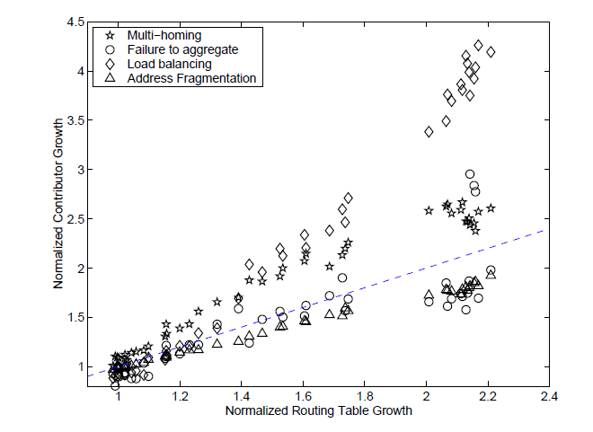
On characterizing BGP Routing Table Growth (98~02)
3. Growth rate of each contributors
Dashed line indicates overall routing table growth
Load balancing and multi-homing contributions grow faster than the overall routing table
Load balancing has surpassed multihoming becoming the fastest growing contributor

Slide 11
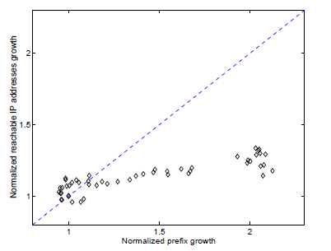
On characterizing BGP Routing Table Growth (98~02)
4. Routing table size & routable addresses
Compare the number of prefixes and the number of IP addresses that are covered by at least one prefix in the routing table
expanding of reachable IP address space contributes little to the rapid growth of routing table size

Slide 12
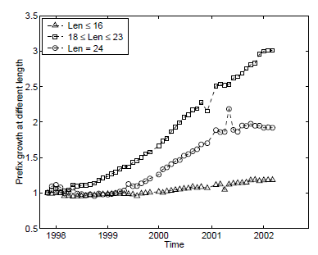
On characterizing BGP Routing Table Growth (98~02)
5. Prefix growth at different mask length
The number of prefixes of length greater than 17 and less than 24 has tripled and grow the fastest.
The number of prefixes of length 24 has doubled whereas the number of prefixes of length 16 does not change much during the last four years.

Slide 13
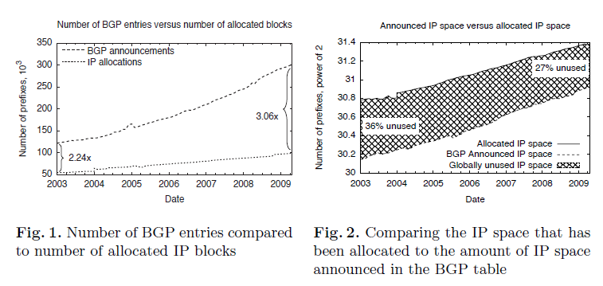
BGP Routing Table : Trends and Challenges
1. Introduction
The number of the global routing table entries has more than doubled.
The amount of allocated but not announced in routing tables has ranged from a little over 1/3 to a little over 1/4 of the total.

Slide 14
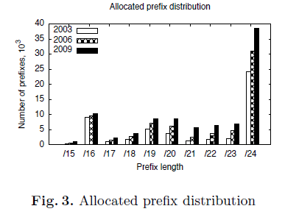
BGP Routing Table : Trends and Challenges
2. IP allocation dynamics
Allocated IP block sizes
The number of allocations increasing for every prefix length in every year.
/24 prefix allocations are the most prevalent
Almost no increase in /16 blocks
Growing trend toward smaller blocks as the IPv4 address space approaches saturation.

Slide 15
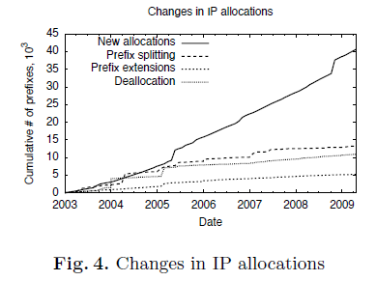
BGP Routing Table : Trends and Challenges
2. IP allocation dynamics
Yearly distribution of IP allocations
40k
Prefix splitting : dividing of one prefix into multiple smaller prefixes (13k)
Prefix extension : aggregating of an existing prefix with its adjacent, previously unallocated address space (5k)
Deallocation : withdrawing of a prefix allocation (10k)
Notes:
Steady, quasi-linear growth in recent years suggests that the increase in allocations will continue at a similar, moderate pace after
IPv6 deployment.

Slide 16
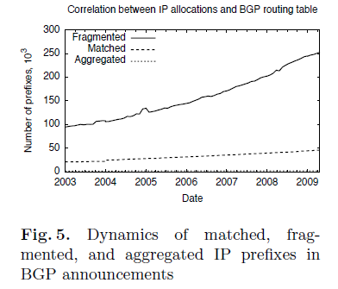
BGP Routing Table : Trends and Challenges
3. BGP routing table growth factors
- IP block fragmentation
83%
17%
Matched = exact form of they were issued by RIRs
For various possible reasons (e.g., geographical dispersion), ISPs split up allocated blocks into a number of sub-blocks and announce each of these independently.
Its primary intent, to reduce the number of entries in the routing table, is outweighed far more by other policy routing choices

Slide 17
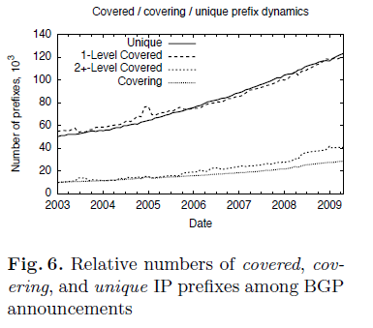
BGP Routing Table : Trends and Challenges
3. BGP routing table growth factors
- Duplicate announcements of IP blocks
1-level and unique curves, the number of IP prefixes in the BGP table which are covered by exactly one bigger prefix is nearly the same as the number of unique prefixes.
There is moreover a substantial number of prefixes that have several layers of coverage.
This finding proves that prefix duplication is common practice on the Internet.
Incentive for the duplication : multihoming

Slide 18
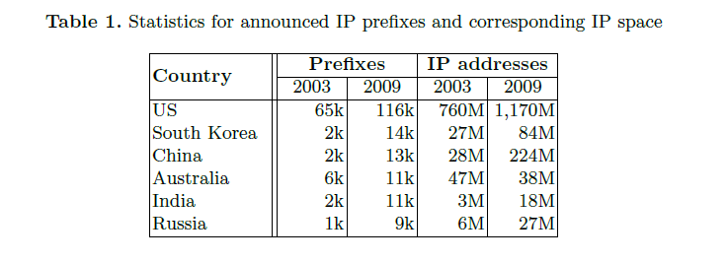
BGP Routing Table : Trends and Challenges
4. BGP routing table contents
- BGP announcements by geographical region
The United States retains its leading position
Some countries announce a large number of relatively small prefixes (South Korea)

Slide 19
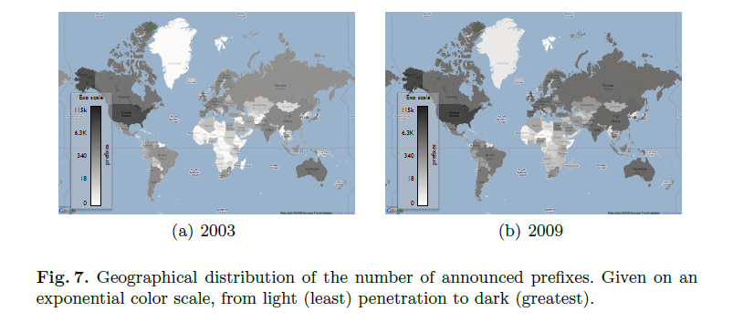
BGP Routing Table : Trends and Challenges
4. BGP routing table contents
- BGP announcements by geographical region
All regions show various degrees of greater Internet hosting.
While the United States retains the lead position throughout the years measured, several regions with emerging economies exhibit marked change (toward darker shades) within the six-year span, such as Russia, China, and India.

Slide 20
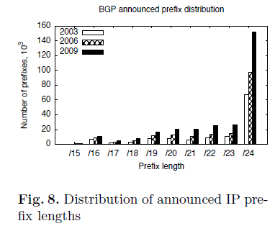
BGP Routing Table : Trends and Challenges
4. BGP routing table contents
- Lengths of announced IP prefixes
The majority of the global routing table entries are /24 prefixes and account for more than 53% of the entries.
/24 prefixes has nearly doubled between 2003 and 2009, but the number of blocks allocated that are actually /24 in size is 4 times smaller

Slide 21
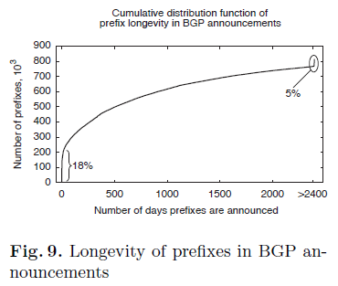
BGP Routing Table : Trends and Challenges
4. BGP routing table contents
- Longevity distribution of BGP entries
5% of all prefixes remain stable over the six-year period
18% of all prefixes observed are active for only short periods of time (i.e., 1–3 days).
Spammers who hijack other’s prefix, announce it for a brief time, and send virtually untraceable spam messages
configuration errors.
normal BGP operations, where some prefix becomes briefly visible, as for example when a primary network channel malfunctions.

Slide 22
Discussion
Is the quantification metrics measuring growth factors valid?
How to reduce the table size while maintaining number of prefixes?
Why South Korea announced a large number of relatively small prefixes?
IPv4 exhaustion and current state of IPv6 allocation?

Slide 23
GIRO Address Scheme
Discussion
ASN
geolocation
SID
Subnet and host
External component
(G-prefix)
Internal component
Including ASN upfront in the address ensures that pkts are routed primarily based on policies
Geolocation information serves as secondary hint
Traffic slice (SID) divides the incoming traffic to the G-prefix, e.g. one SID per provider
The internal component is not announced to other networks; it’s used to route pkts inside the origin network
Notes:
Maybe mention that the format of the geolocation field is lat/lon, but for this paper we assume country.region.city

Slide 24
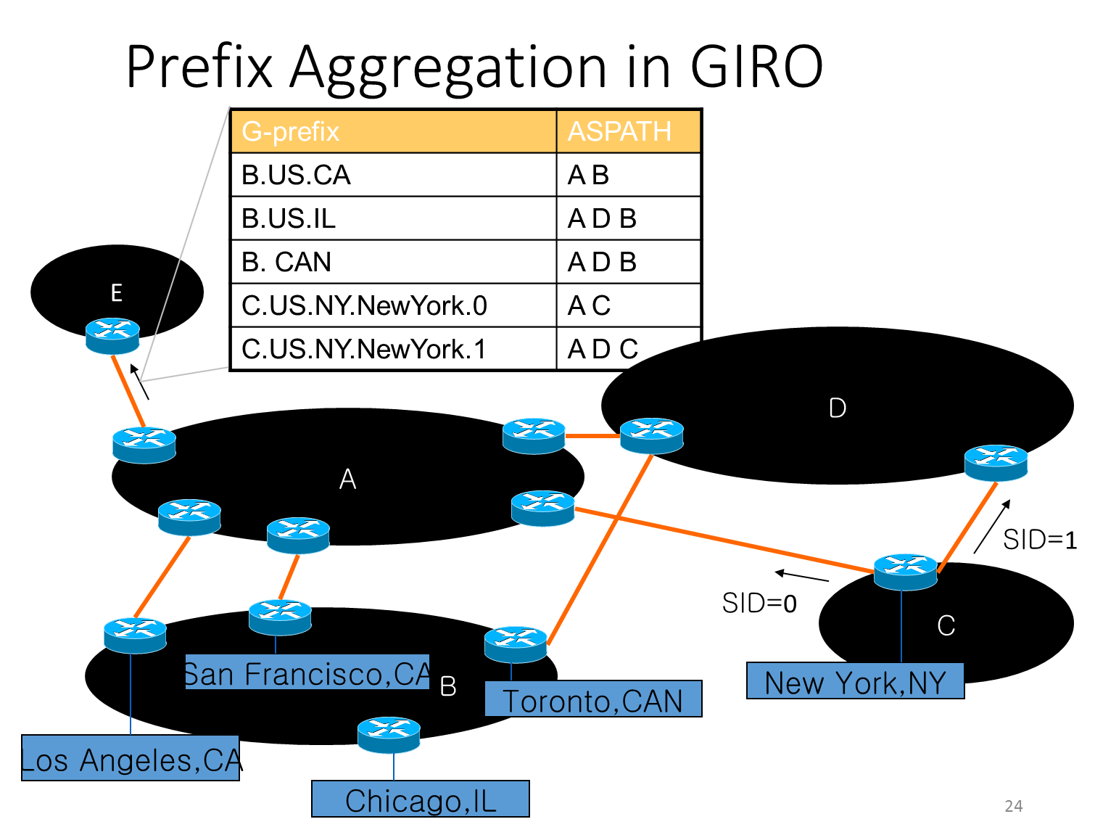
Discussion

Slide 25
Discussion
IPv4 exhaustion and current state of IPv6 allocation?
Because of the demand of the growing Internet, the small address space finally suffered exhaustion on February 3, 2011
Country/Region Name | Percentage of used IPv6 space | IPv6 Assignments and Allocations | IPv6 Allocations | IPv6 Assignments
Brazil | 39.67115098% | 3 | 3 | 0
United States | 11.07051810% | 2571 | 1604 | 967
Japan | 6.76423444% | 397 | 366 | 31
Germany | 6.44004484% | 600 | 498 | 102
China | 5.68015466% | 173 | 167 | 6
France | 5.20816673% | 279 | 248 | 31
Australia | 5.15324597% | 466 | 334 | 132
European Union | 3.74029554% | 85 | 55 | 30
Republic of Korea | 3.15181890% | 118 | 111 | 7

